Slide 1

BIG DATA TRACK
What is BD?
By Sanket
Learn Well Technocraft, Aundh, Pune
Notes:
Cover Option2

Slide 2

What is BigData?
Origin of BigData
Notes:
Cover Option2

Slide 3
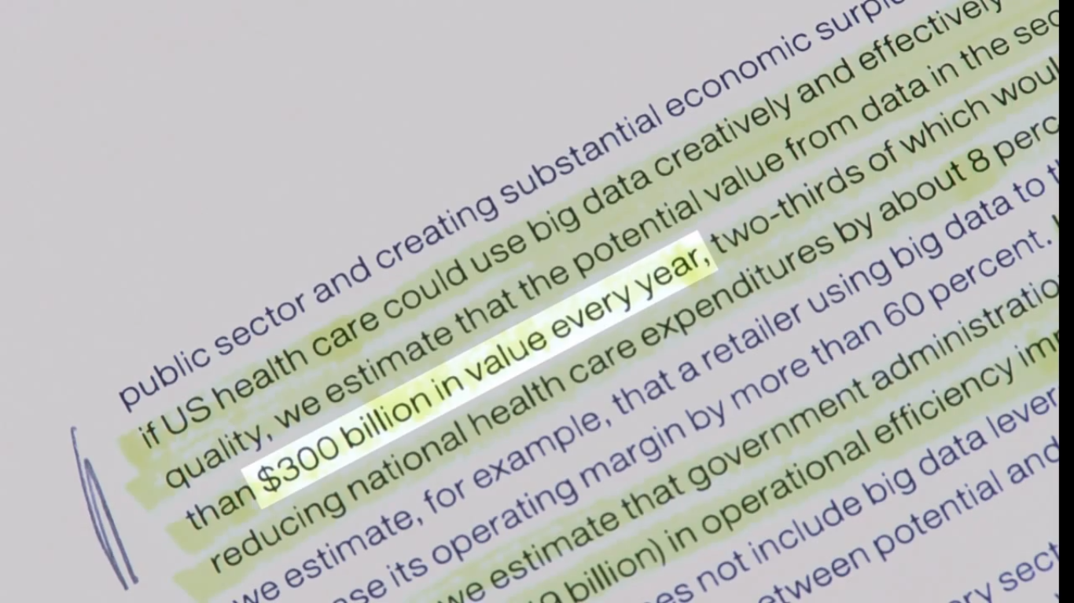
McKinsey Global Institute estimated that the US healthcare sector could achieve $300 billion in efficiency and quality savings every year by leveraging Big Data.
What is BD?
Notes:
This is the structure of bullet points in a lecture

Slide 4
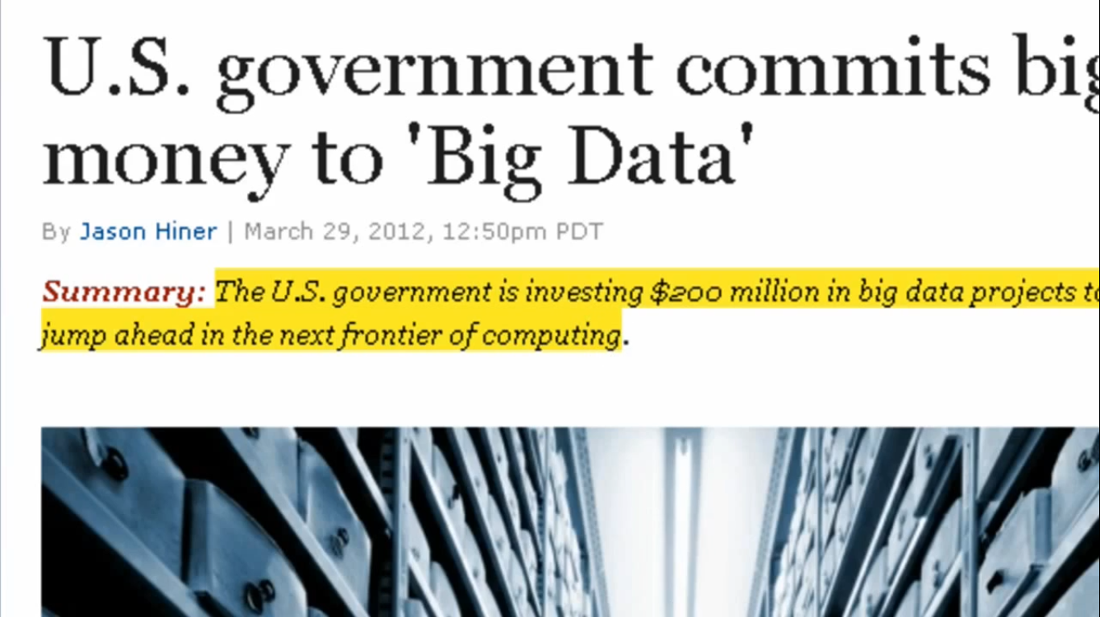
Implication of Big Data
What is BD?
Notes:
This is the structure of bullet points in a lecture

Slide 5
;-)
What is BD?
4

Slide 6
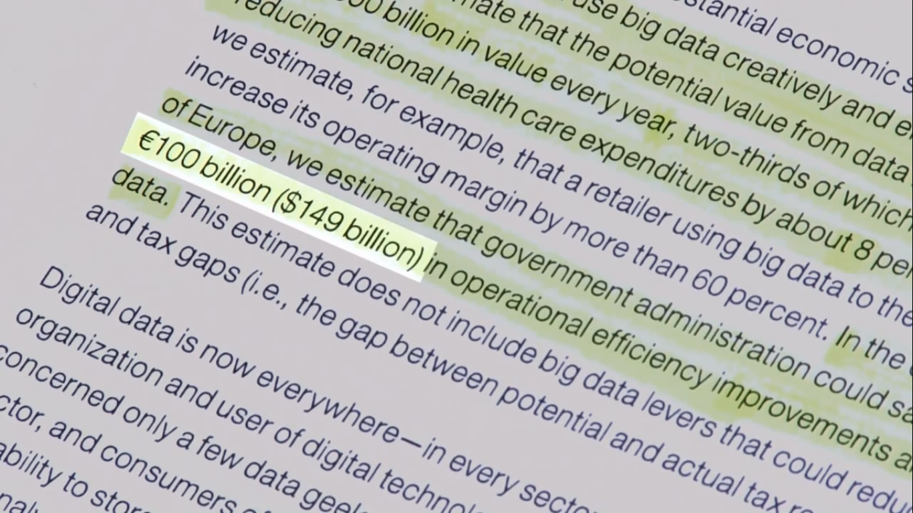
Similarly Europe could save $149 billion in operational efficiency improvements if they could leverage BigData efficiently
What is BD?
Notes:
This is the structure of bullet points in a lecture

Slide 7
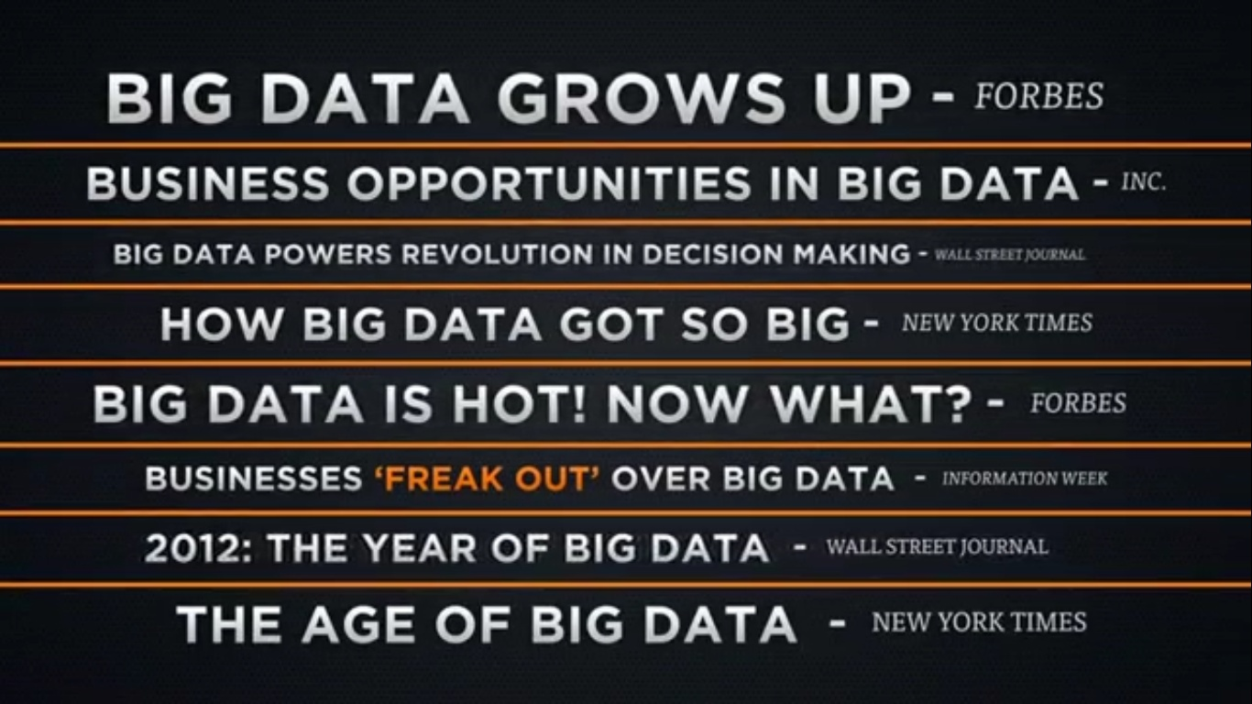
What is BD?
Notes:
This is the structure of bullet points in a lecture

Slide 8
What is BigData?
BigData in our daily life!!
Notes:
Cover Option2

Slide 9
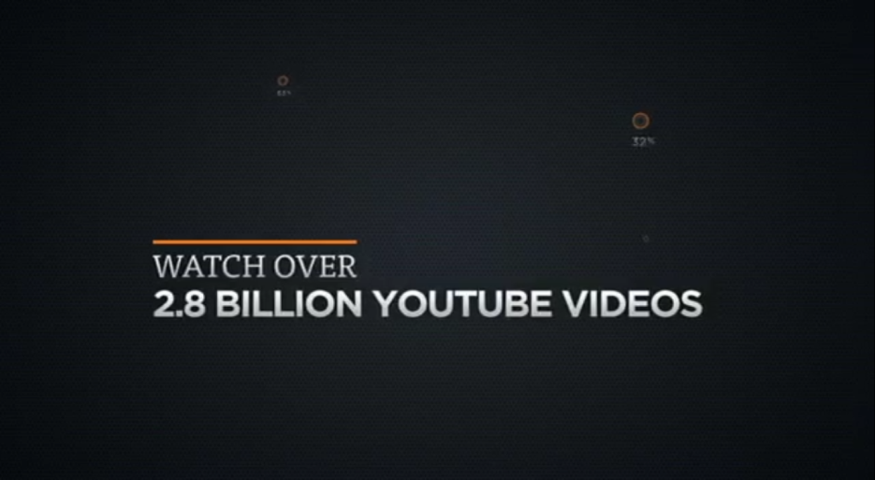
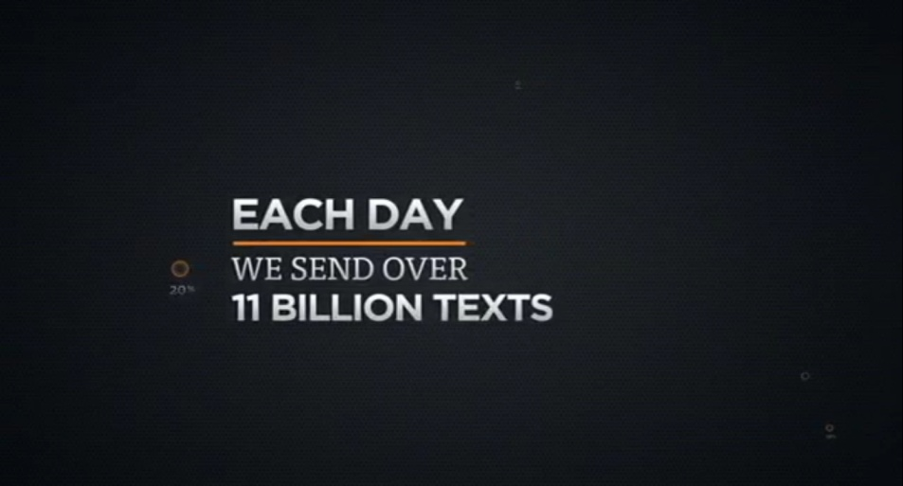
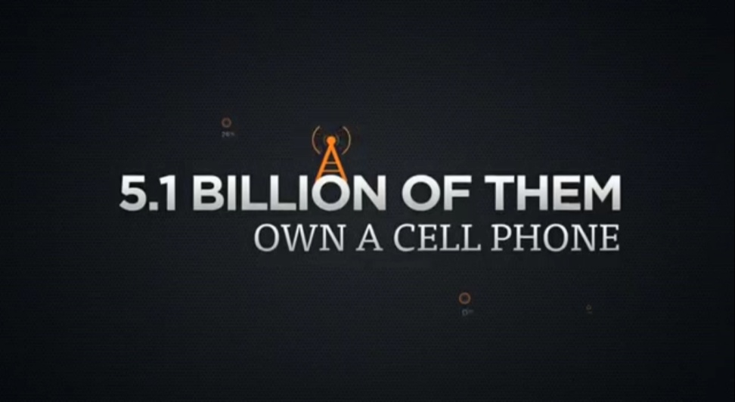
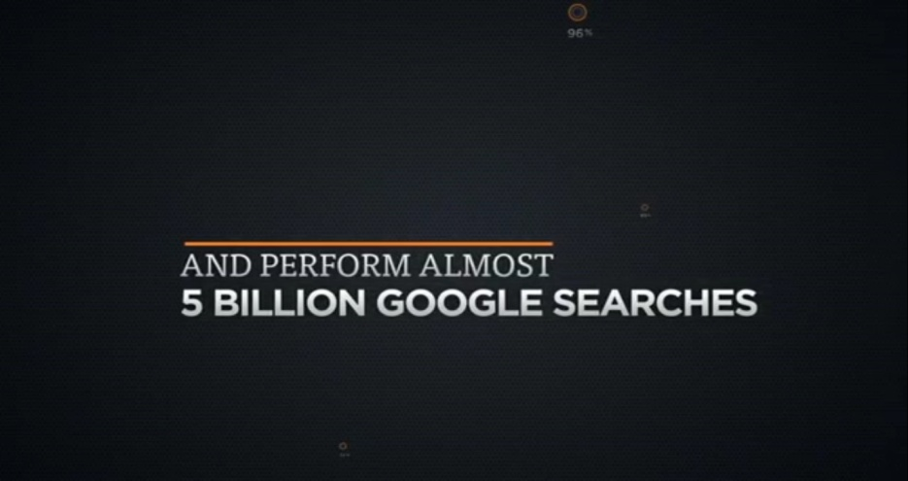
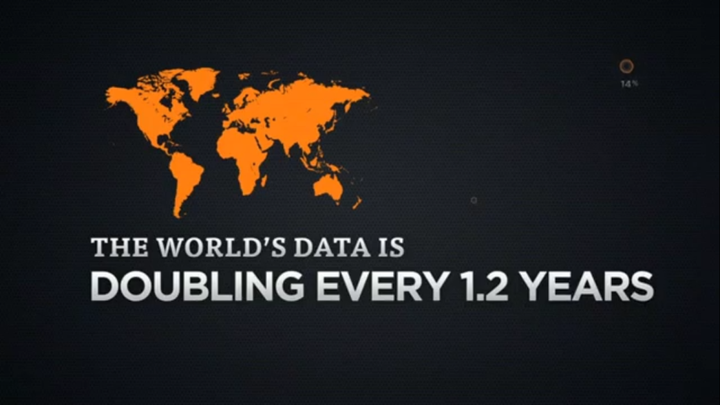
What is BD?
Notes:
This is the structure of bullet points in a lecture

Slide 10

There are 40 billion pieces of content shared on Facebook every day.
What is BD?
Notes:
This is the structure of bullet points in a lecture

Slide 11

Wal-Mart handles more than 1 million customer transactions an hour.
What is BD?
Notes:
This is the structure of bullet points in a lecture

Slide 12
What is BigData?
Defining BigData
Notes:
Cover Option2

Slide 13
So What is Big Data?
Big data is large and complex data sets collected from various sources like Sensors, Social Media, Satellite images, Audio, Video, RFID etc.
Big data is data that exceeds the processing capacity of conventional database systems.
How ‘Big’ is big?
GB, TB, PB , ZB?? NO..
Data is Big when the organization’s ability to handle, store and analyze exceeds its capacity.
What is BD?
Notes:
This is the structure of bullet points in a lecture

Slide 14
Definition of Big Data
There is no universally accepted deﬁnition of Big Data.
Wikipedia defines Big Data as :
Big data is the term for a collection of data sets so large and complex that it becomes difficult to process using on-hand database management tools or traditional data processing applications.
Gartner deﬁnes Big Data as:
Big data is high-volume, high-velocity. , and high-variety information assets that demand cost-effective, innovative forms of information processing for enhanced insight and decision-making.
What is BD?
Notes:
This is the structure of bullet points in a lecture

Slide 15
What is BigData?
Characterizing BigData
Notes:
Cover Option2

Slide 16
Three Characteristics of Big Data V3s
Volume
Velocity
Data Speed
Variety
Data Types
Data quantity
What is BD?
Notes:
Acco.to IBM
16

Slide 17
Volume
A typical PC might have had 10 gigabytes of storage in 2000.
Today, Facebook ingests 500 terabytes of new data every day.
Boeing 737 will generate 240 terabytes of flight data during a single flight across the US.
What is BD?
Notes:
This is the structure of bullet points in a lecture

Slide 18
Velocity
Clickstreams and ad impressions capture user behavior at millions of events per second
Infrastructure and sensors generate massive log data in real-time
On-line gaming systems support millions of concurrent users, each producing multiple inputs per second.
What is BD?
Notes:
This is the structure of bullet points in a lecture

Slide 19
Variety
Big Data isn't just numbers, dates, and strings. Big Data is also geospatial data, 3D data, audio and video, and unstructured text, including log files and social media.
Traditional database systems were designed to address smaller volumes of structured data, fewer updates or a predictable, consistent data structure.
Big Data analysis includes different types of data
What is BD?
Notes:
This is the structure of bullet points in a lecture

Slide 20




The Model Has Changed…
The Model of Generating/Consuming Data has Changed
Old Model: Few companies are generating data, all others are consuming data
New Model: all of us are generating data, and all of us are consuming data
What is BD?
Notes:
This is the structure of bullet points in a lecture

Slide 21
What is BigData?
Sources of BigData
Notes:
Cover Option2

Slide 22
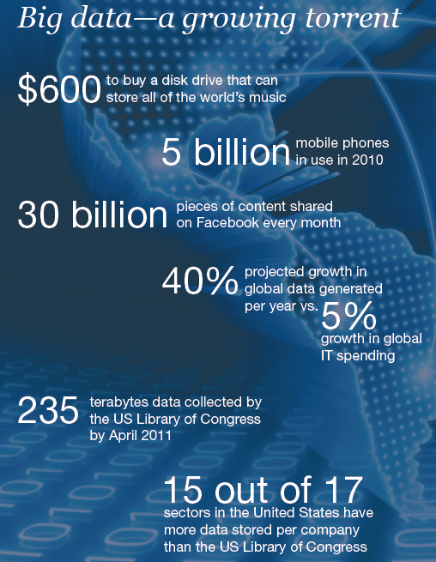
Data generation points Examples
Mobile Devices
Microphones
Readers/Scanners
Science facilities
Programs/ Software
Social Media
Cameras
Notes:
This is the structure of bullet points in a lecture

Slide 23
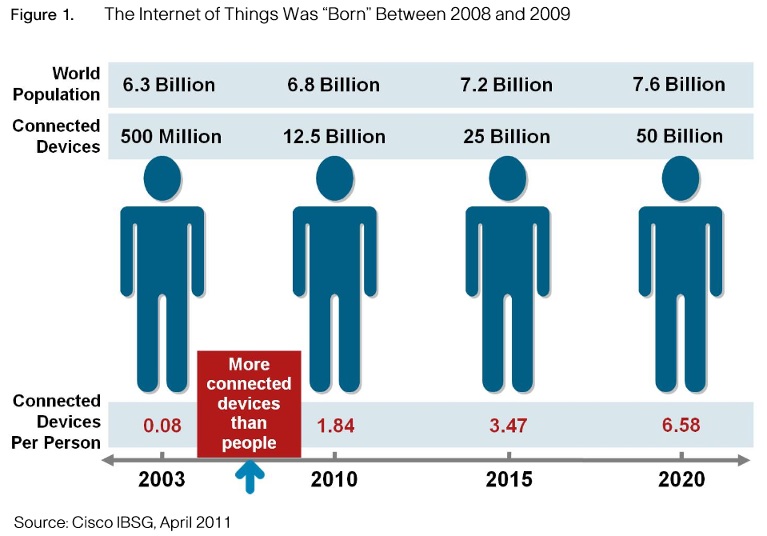
Why Big Data
Notes:
This is the structure of bullet points in a lecture

Slide 24
What is BigData?
Your future lies with BigData
Notes:
Cover Option2

Slide 25
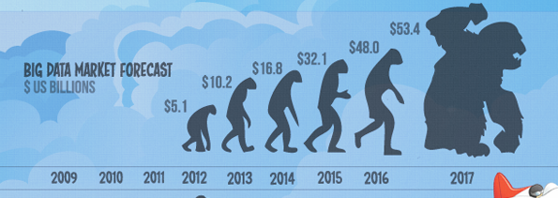
$300 billion potential annual value to US health care.
$600 billion potential annual consumer surplus from using personal location data.
60% potential in retailers’ operating margins.
What is BD?
21

Slide 26


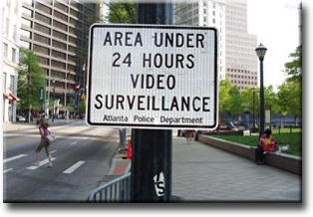



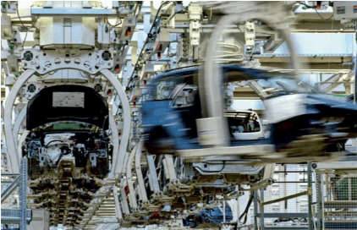

Application Of Big Data Analytics
Smarter Healthcare
Multi-channel sales
Homeland
Security
Telecom
Trading
Analytics
Traffic Control
Manufacturing
Search
Quality
What is BD?
Notes:
This is the structure of bullet points in a lecture

Slide 27
Future of Big Data
This industry on its own is worth more than $100 billion and growing at almost 10% a year which is roughly twice as fast as the software business as a whole.
In February 2012, the open source analyst firm Wikibon released the first market forecast for Big Data , listing $5.1B revenue in 2012 with growth to $53.4B in 2017
The McKinsey Global Institute estimates that data volume is growing 40% per year, and will grow 44x between 2009 and 2020.
What is BD?
Notes:
This is the structure of bullet points in a lecture

Slide 28
What is BigData?
Problem and Solution
Notes:
Cover Option2

Slide 29
Problem:
Storing and Analyzing
“Big Data”
What is BD?
Notes:
This is the structure of bullet points in a lecture

Slide 30

Solution:
Move compute to data
Hey there, I’m Hadoop and I can do that for you..
What is BD?
Notes:
This is the structure of bullet points in a lecture

